Slide 1

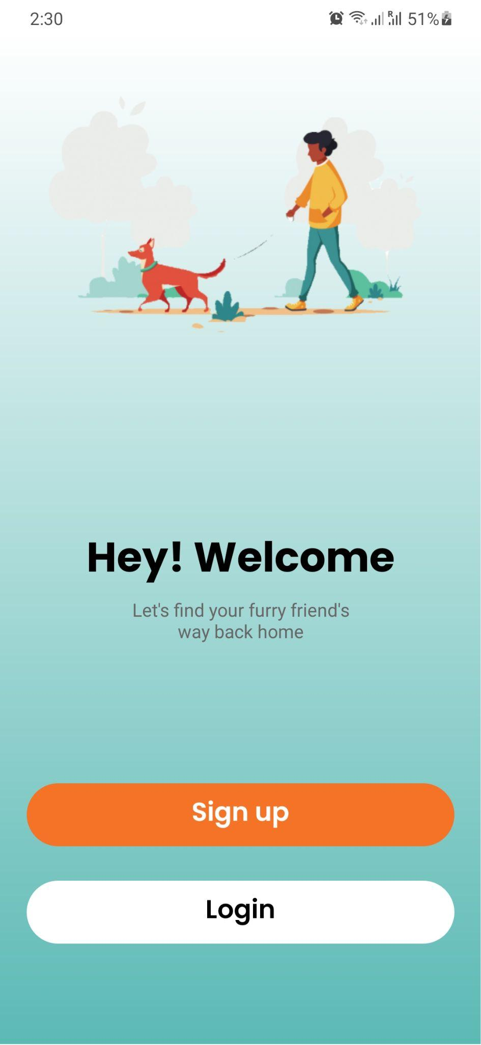
PetRadar
Final Project By:
Group 1
Client Team:
Group 4

Slide 2
Summary
The Pet Radar project is a Android mobile app that allows users to report lost pets and share their details, with a QR code feature for anyone to access and contact the owner. Its aim is to help reunite lost pets with their owners through community engagement
How : Using QR Code, Call Feature, Adding the posts through App.

Slide 3
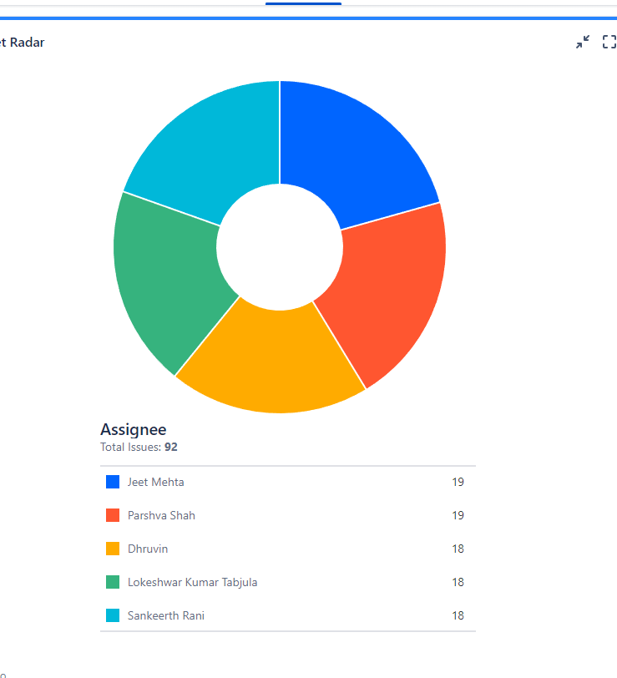
Jira Issue tracker
Jira Link: https://csci5308grp1.atlassian.net/jira/dashboards/10001

Slide 4
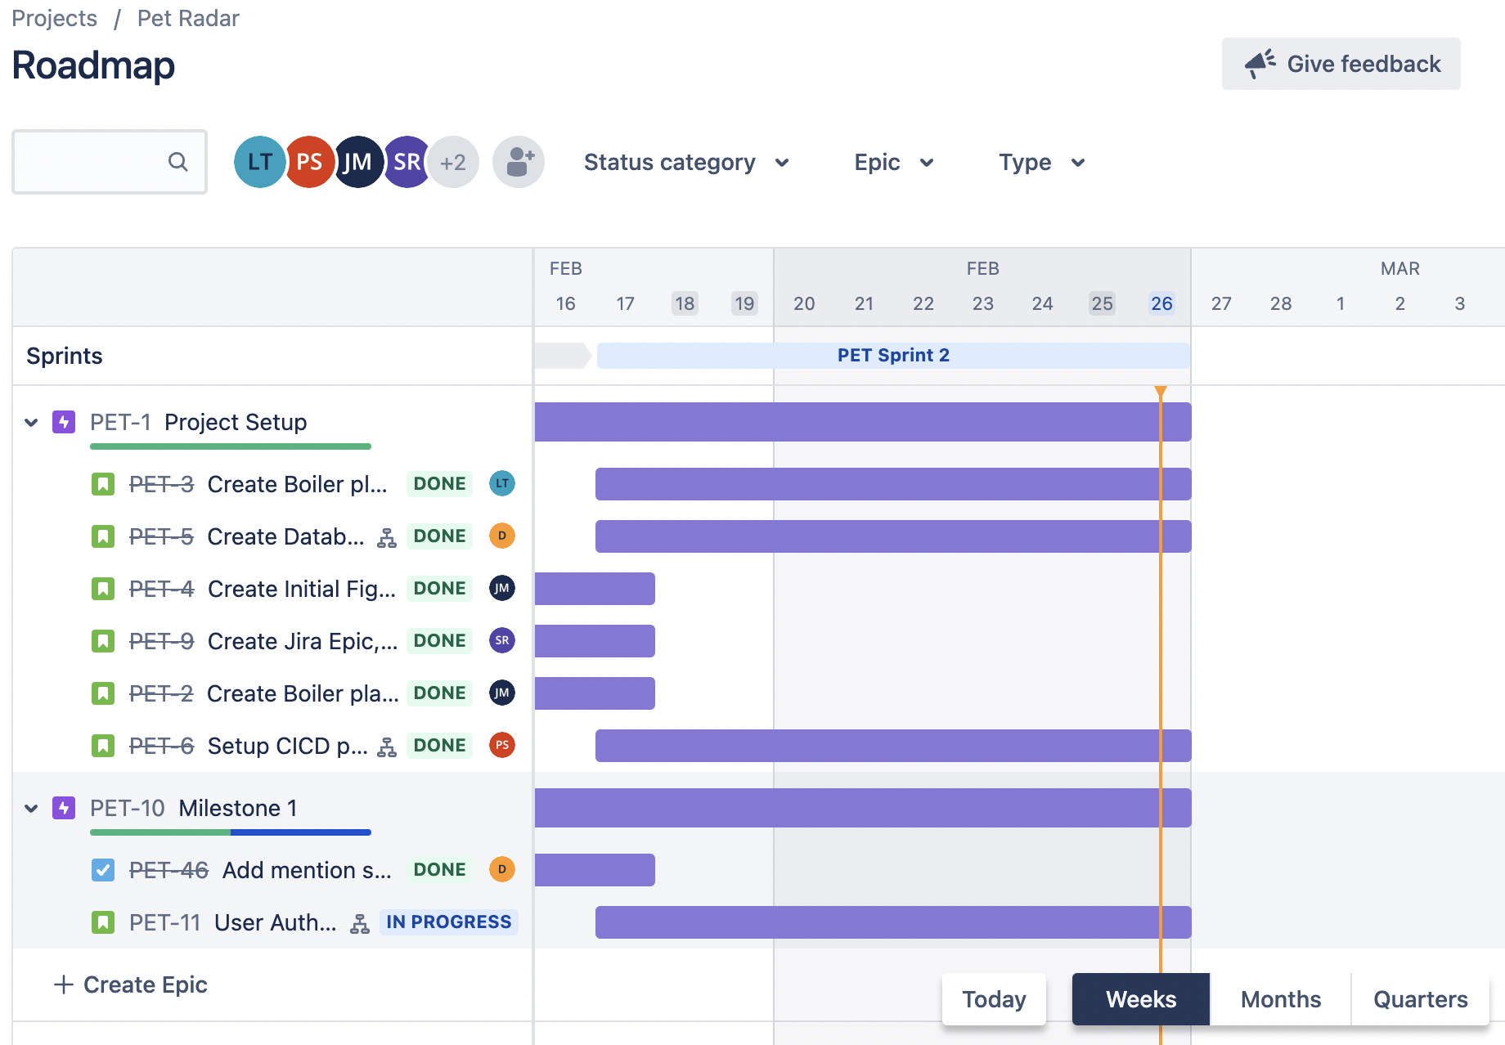

Slide 5
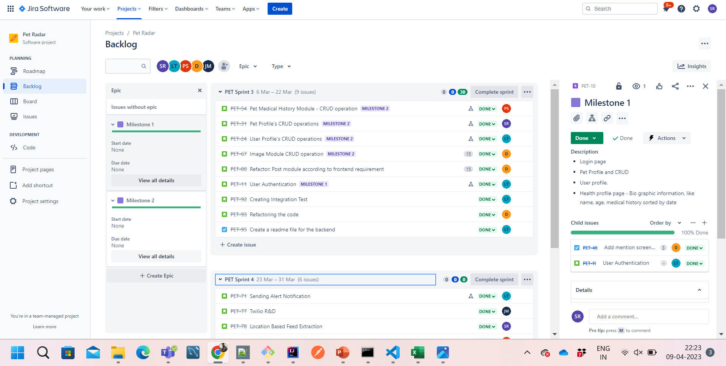

Slide 6
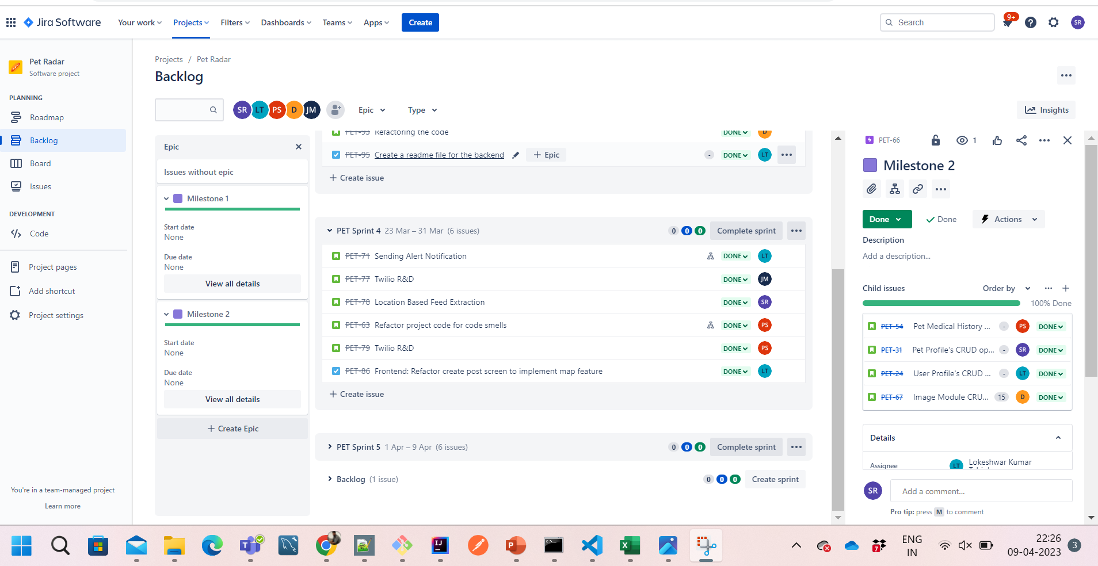

Slide 7
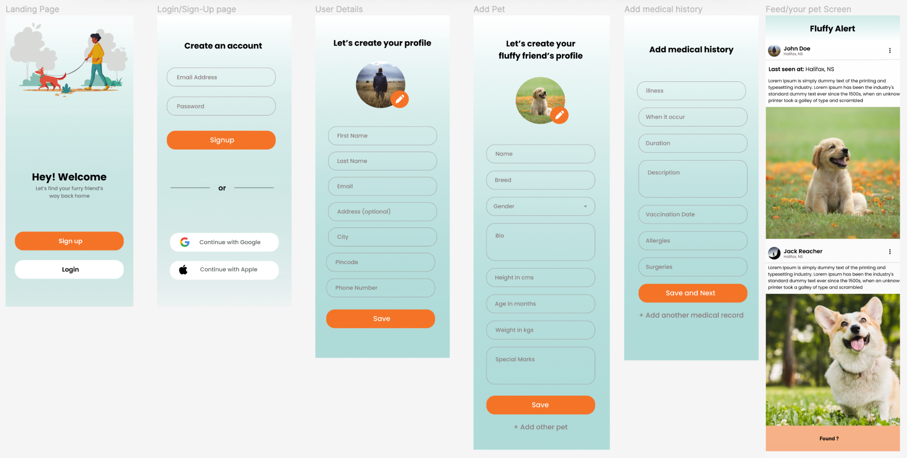

Slide 8
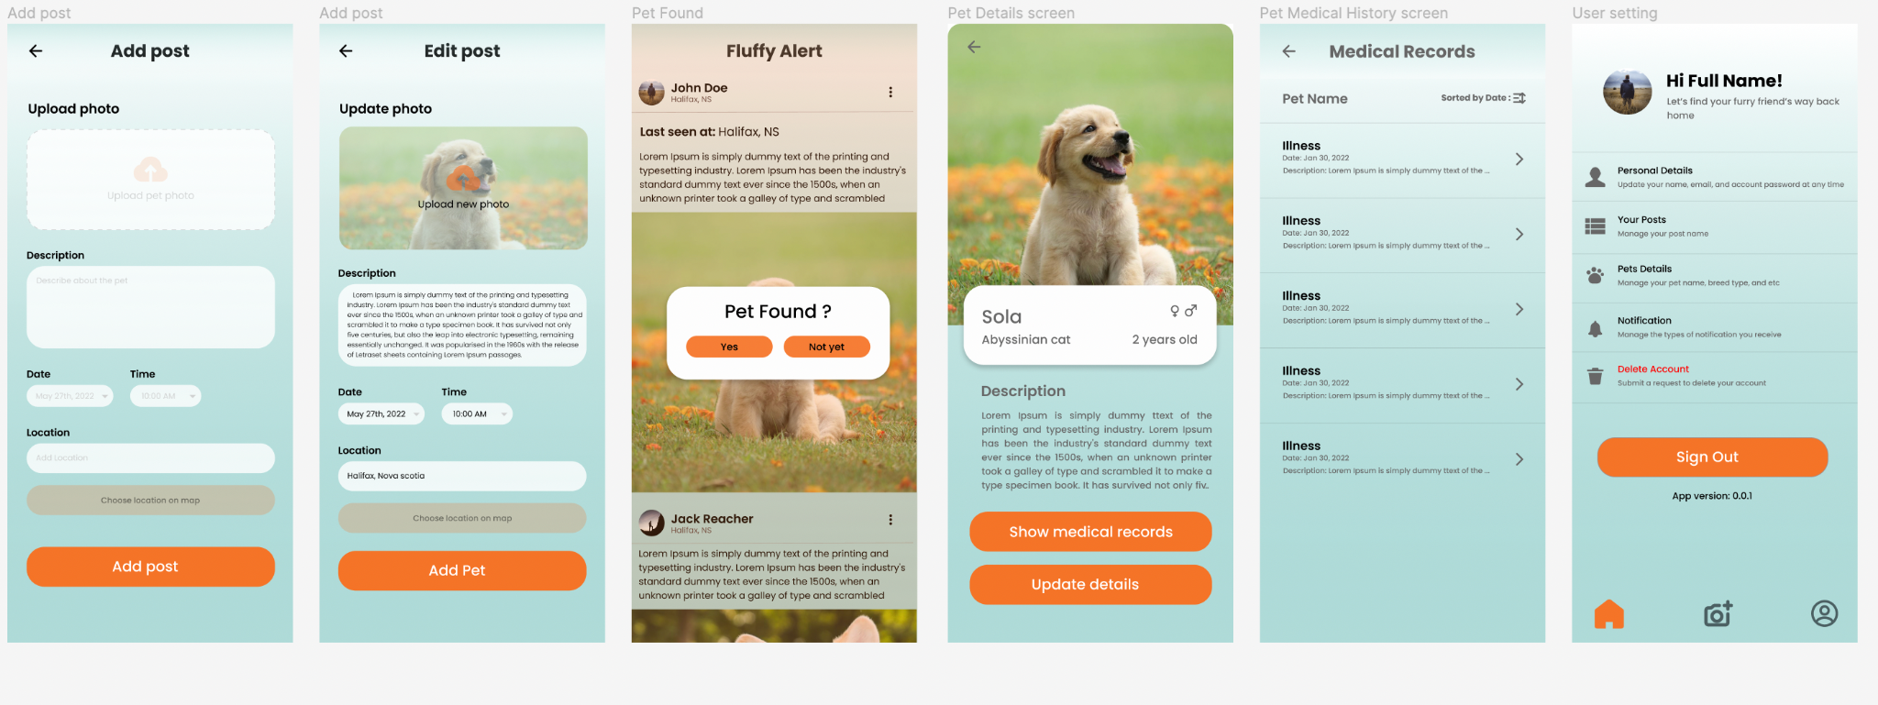

Slide 9
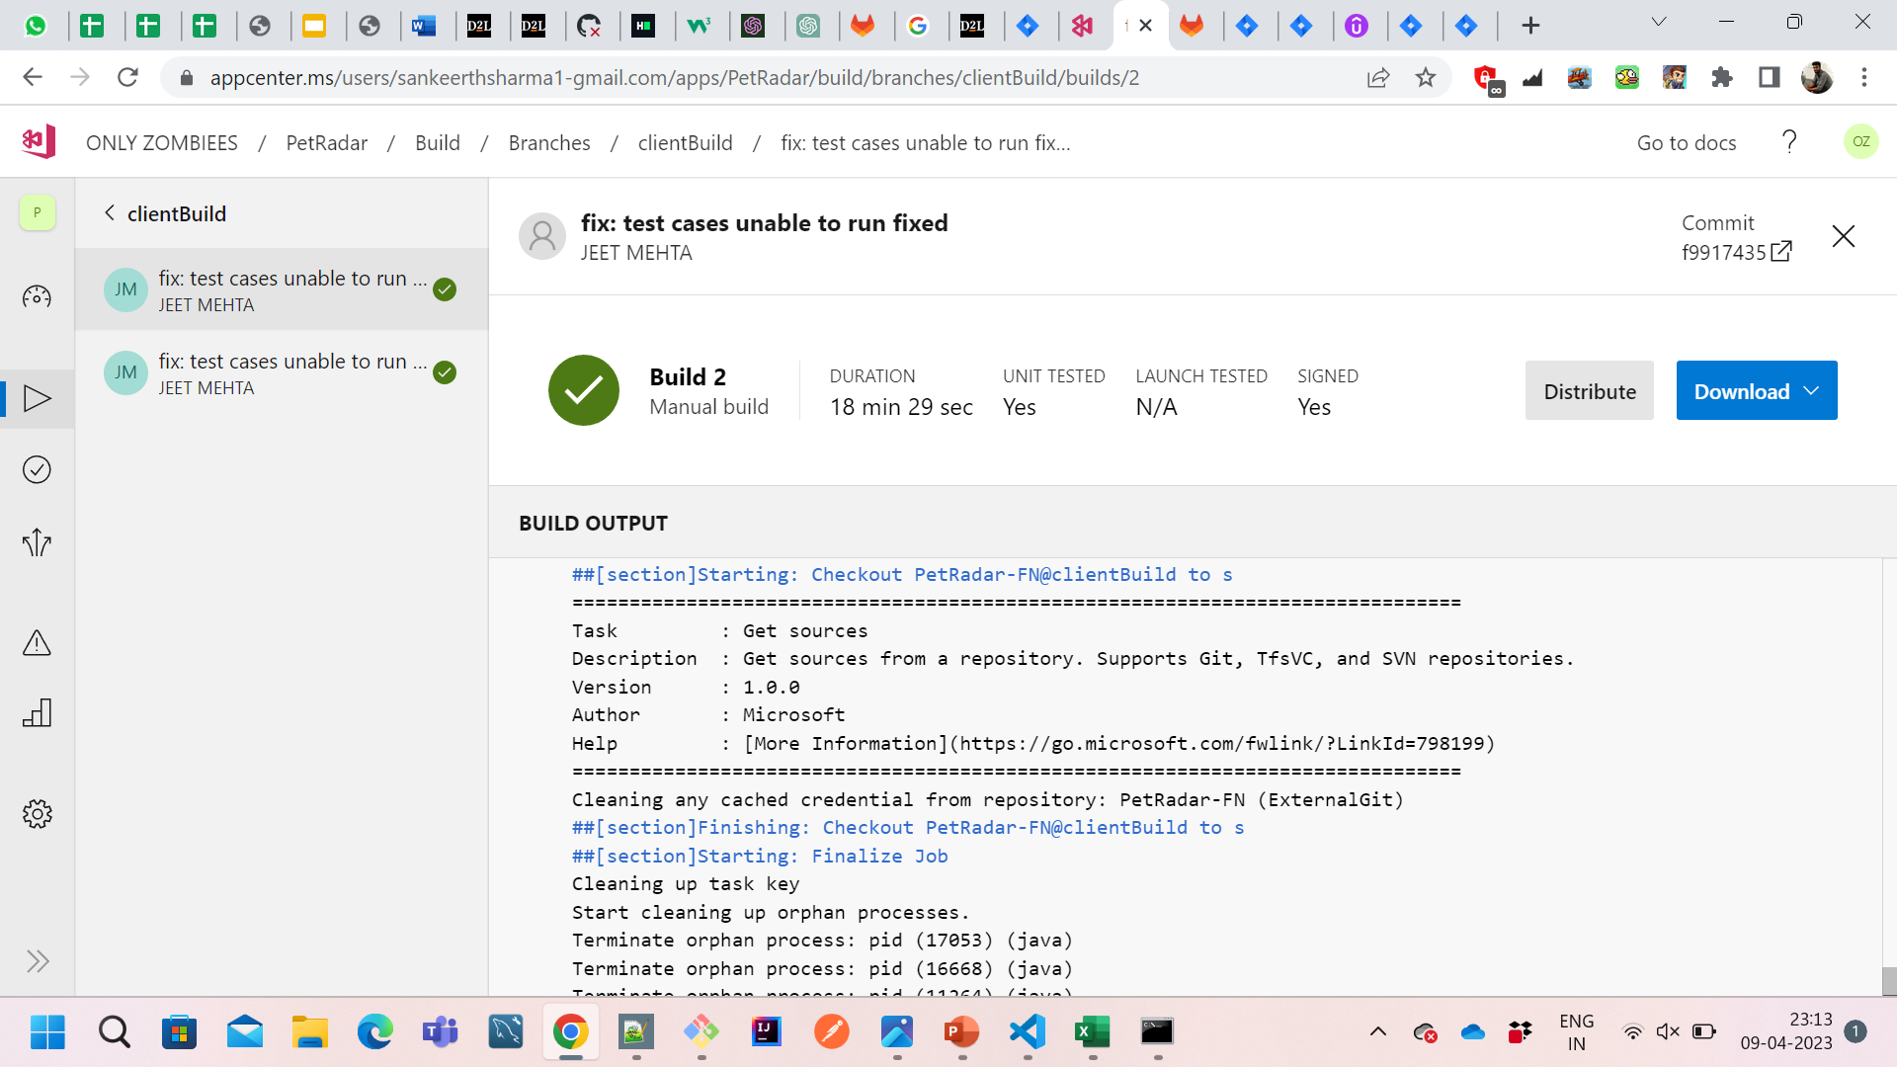
CI/CD Front End

Slide 10
Milestones Provided By Client:
Milestone 1
Milestone 3
Milestone 2
Milestone 4
Basic mobile app that does:
user authentication
a CRUD interface for pet management
A feed that would allow users to see missing pets in the area
Sending an SOS push notification to nearby users when a pet has gone lost
Twilio call forwarding implementation with user authentication
QR code generation and implementation
An all-users-accessible webpage containing the pet's information linked to the QR code
on-click navigation to nearby emergency facilities
Realtime medical information access

Slide 11
Given And Implemented Features
Given Features | Achieved or Not
User Authentication​ | Yes
CRUD interface for pet management​ | Yes
A feed that would allow registered users to see missing pets in the area | Yes
Sending an SOS push notification to nearby users when a pet has gone lost | Yes
Voice call forwarding implementation with user authentication​* | Yes
QR code generation and implementation​ | Yes
An all-users-accessible webpage containing the pet's information linked to the QR code​ | Yes
On-click navigation to nearby emergency facilities​ | Yes
Realtime medical information access​ | No

Slide 12
Features Implemented after Mid-term
QR code generation for the PetProfile.
Implementation of post feed by allow the register user to post if his pet was lost and see the post feed to check if anyone's pet is missing.
Implemented Notification feature to send the notifications to the registered users around 20kms range.
Created a webpage and redirecting any user to it if they scan the QR code.
Implemented the calling feature which will allow the user to call the corresponding owner.
Show them the nearest animal facilities
Implemented the pending APIs integration which are related to above features.

Slide 13
Learnings From the Project
As we are developing the app and our tech stack is React Native for front end we have got a chance to learn more about how React Native works, and specifically how to create screens and navigate to other pages and integrate with backend.
For the backend we were using Springboot framework along side java and it gave us a decent amount of understanding how model view controller architecture works and applying design principles on top of that.
How to do the deployment and run the ci/cd pipelines
Moreover we had a chance to understand Refactoring and Design Patterns which help us to write the code in a more cohesive and maintainable manner.
Getting the post feed based on the location was something new feature which we have implemented.
From backend perspective integrating with AWS for saving and retrieving the images was something new which we had an opportunity to learn from this project.

Slide 14
THANK YOU Group1: Jeet Mehta(B00945900) Sankeerth Rani(B00932027) Dhruvin Dankhara(B00926164) Parshva Shah(B00928689) Lokeshwar Tabjula(B00936909)

